Slide 1
Shell Bootcamp 2024 4 Reflections for Week 1
Neha Ann Shygen
Date : 30-Aug-2024

Slide 2
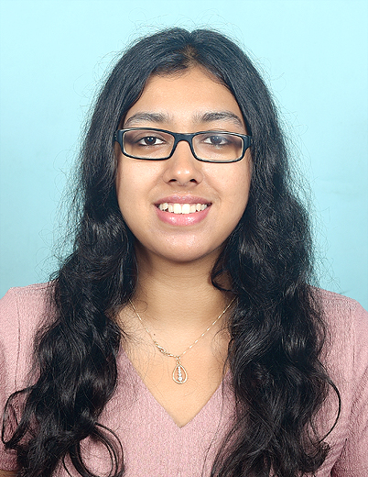
About Me
My motto in life is to learn as much as possible and move ahead in my career path.

Slide 3

My learnings from this week!

Slide 4
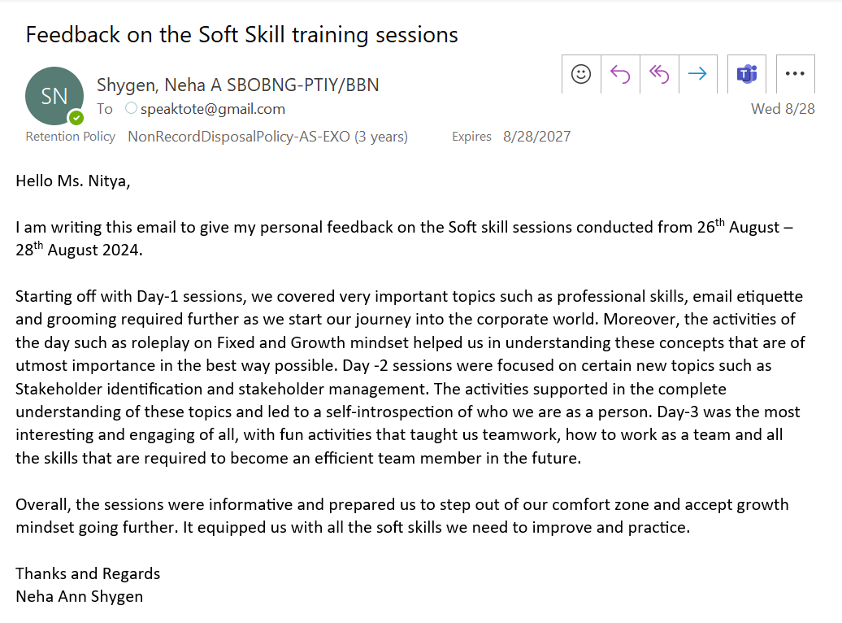
Learning 1 | Email Etiquette and POWER technique
Always use Hello/Dear then first name as salutation.
Write the TO field always at the end.
POWER- Plan, Organize, Write, Edit, Review
CC- to keep an individual in loop
BCC – Blind copy
This email etiquette needs to be followed every time we communicate through email and would be used ahead.

Slide 5
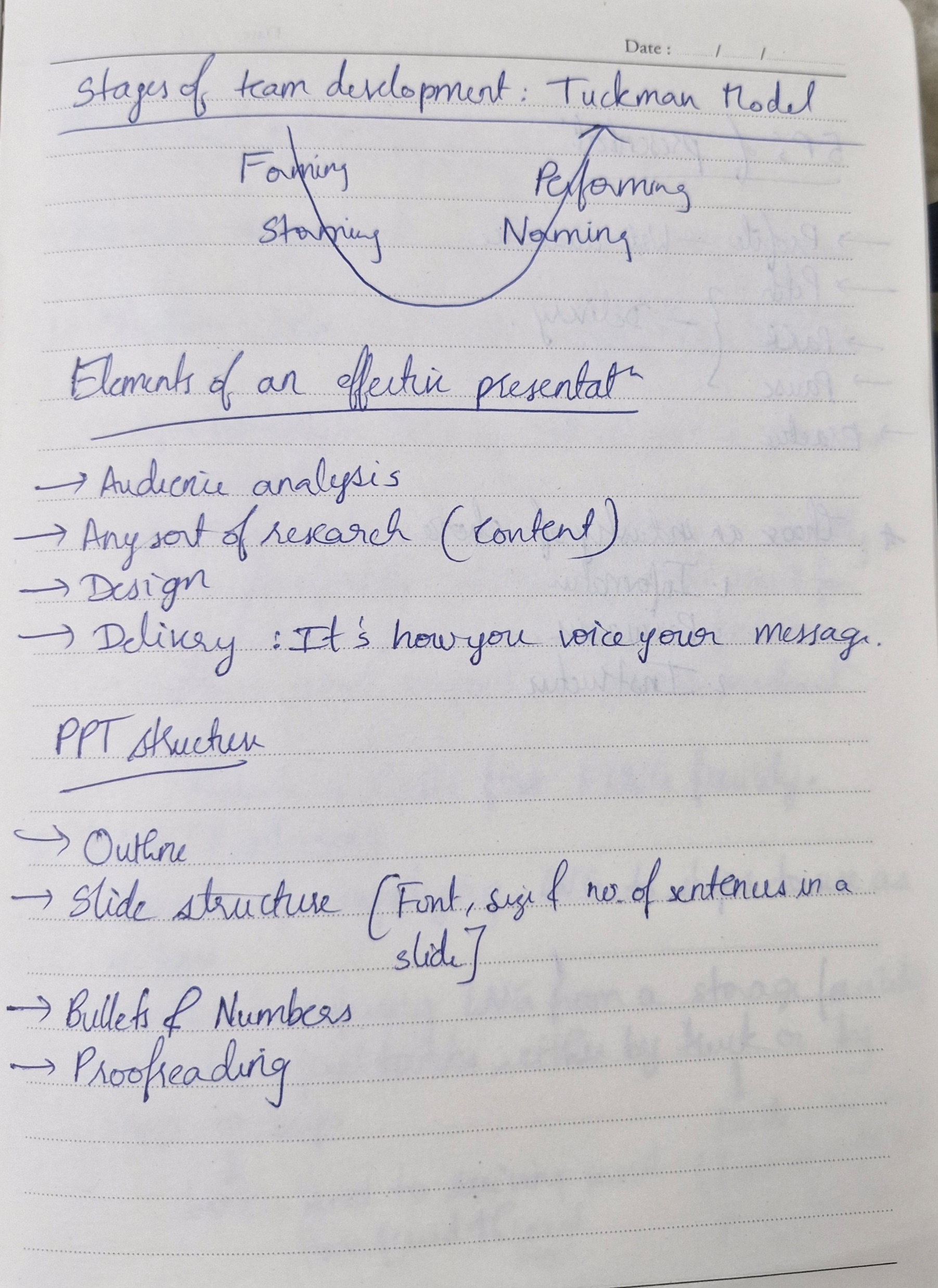
Learning 2 | Stakeholder management, Team building
Stakeholder identification
Internal stakeholder and External Stakeholder classification
This helps us in identifying the important stakeholders and to create a strategic plan to manage them.
Tuckman Model: Forming, Storming, Norming, Performing
Team building and these effective presentation skills help us engaging audience as well as be a good team member.

Slide 6

Learning 3 | BRD and SRS, Software Project management
Business Analyst designs BRD and SRS.
BRD contains business significance.
SRS contains software specifications required for the completion of the project.
Software project management consists of Conflict management, release management, risk management and software configuration management.

Slide 7
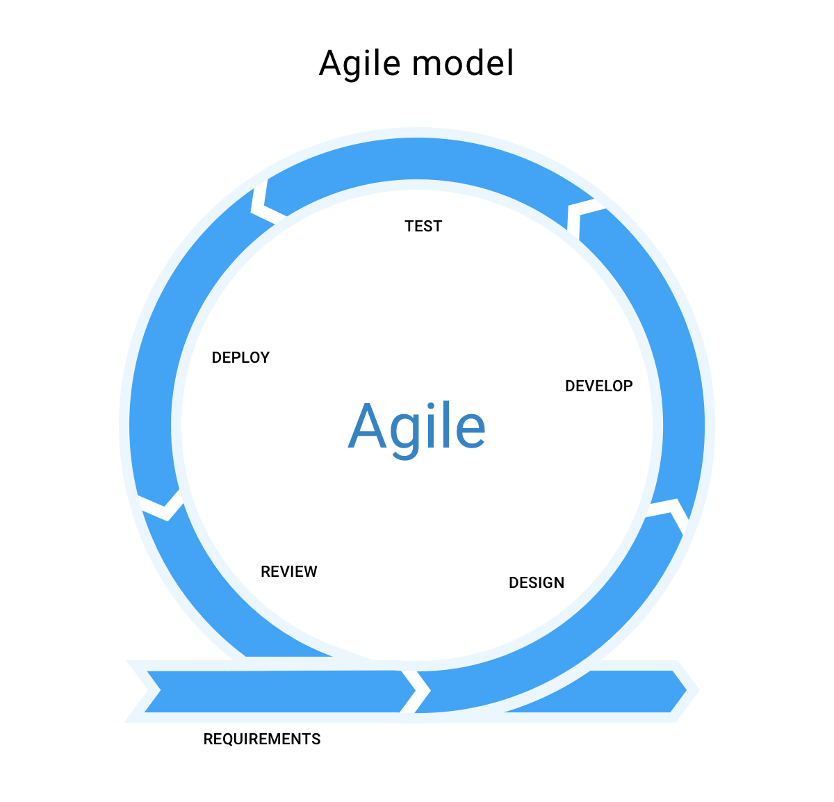
Learning 4 | SDLC models and Agile Scrum ceremonies
SDLC Models: Waterfall, V model, Prototyping model, Agile model.
SDLC: Initial, Analysis, Design, Coding, Testing, Delivery & maintenance.
Scrum ceremonies:
Sprint planning meeting
Daily scrum standup meeting
Sprint grooming meeting
Sprint demo
Sprint retrospective meeting
Parking lot

Slide 8

Relevance of learnings for my organization

Slide 9
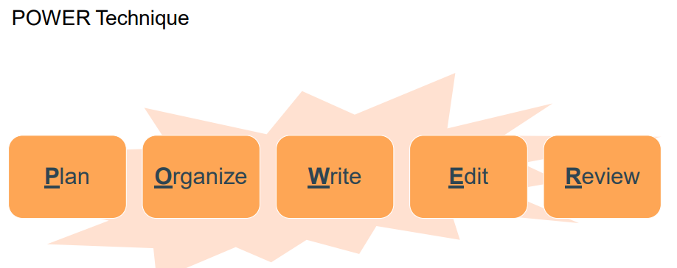
Learning 1 | Email Etiquette and POWER technique
How I feel Shell implements this learning
Email etiquette is a very important part of the IT sector as every important detail is drafted through email.
How I feel Shell benefits from this learning
This teaches us how to be respectful, concise and be formal while writing a mail to any client/ employee.

Slide 10
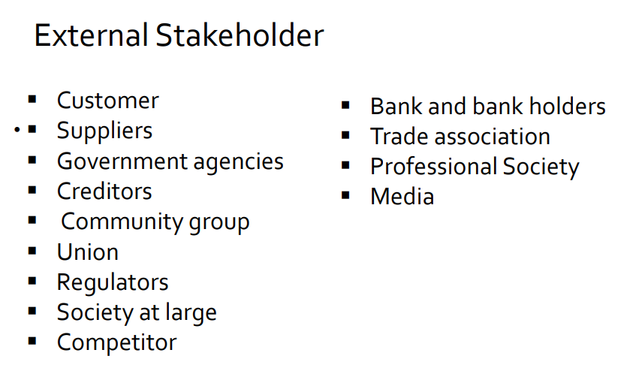
Learning 2 | Stakeholder management, Team building
How I feel Shell implements this learning
Shell initially identifies its stakeholders, classifies them and manages them accordingly.
How I feel Shell benefits from this learning
Shell understands it’s stakeholders very well and uses this to create a strategic plan to stay well connected with stakeholders.

Slide 11
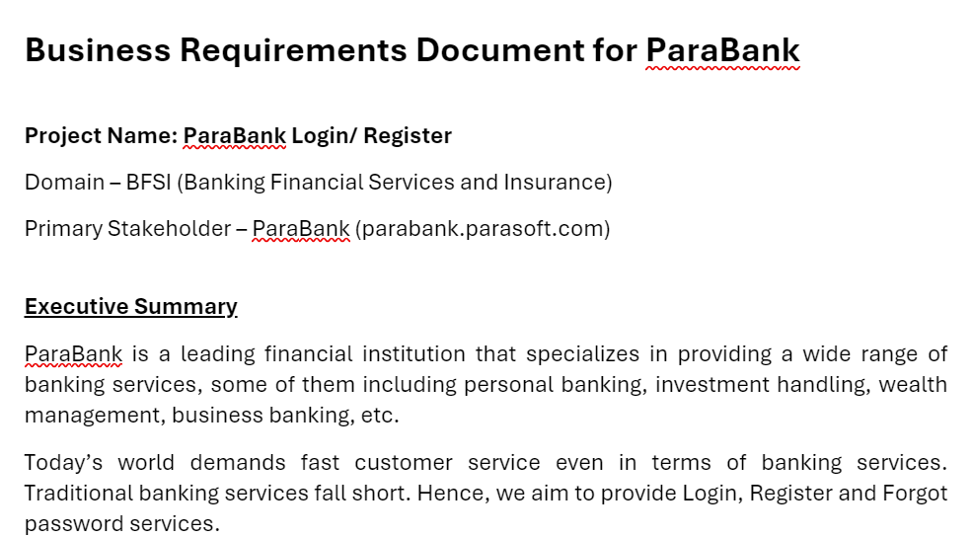
Learning 3 | BRD and SRS, Software Project management
How I feel Shell implements this learning
A business analysis designs both BRD and SRS. Shell BAs perform their responsibilities to ensure the success of a project.
How I feel Shell benefits from this learning
Shell benefits from this because a BA who is very good at designing a BRD and SRS can bring a great project and ensure the successful implementation of the project.

Slide 12
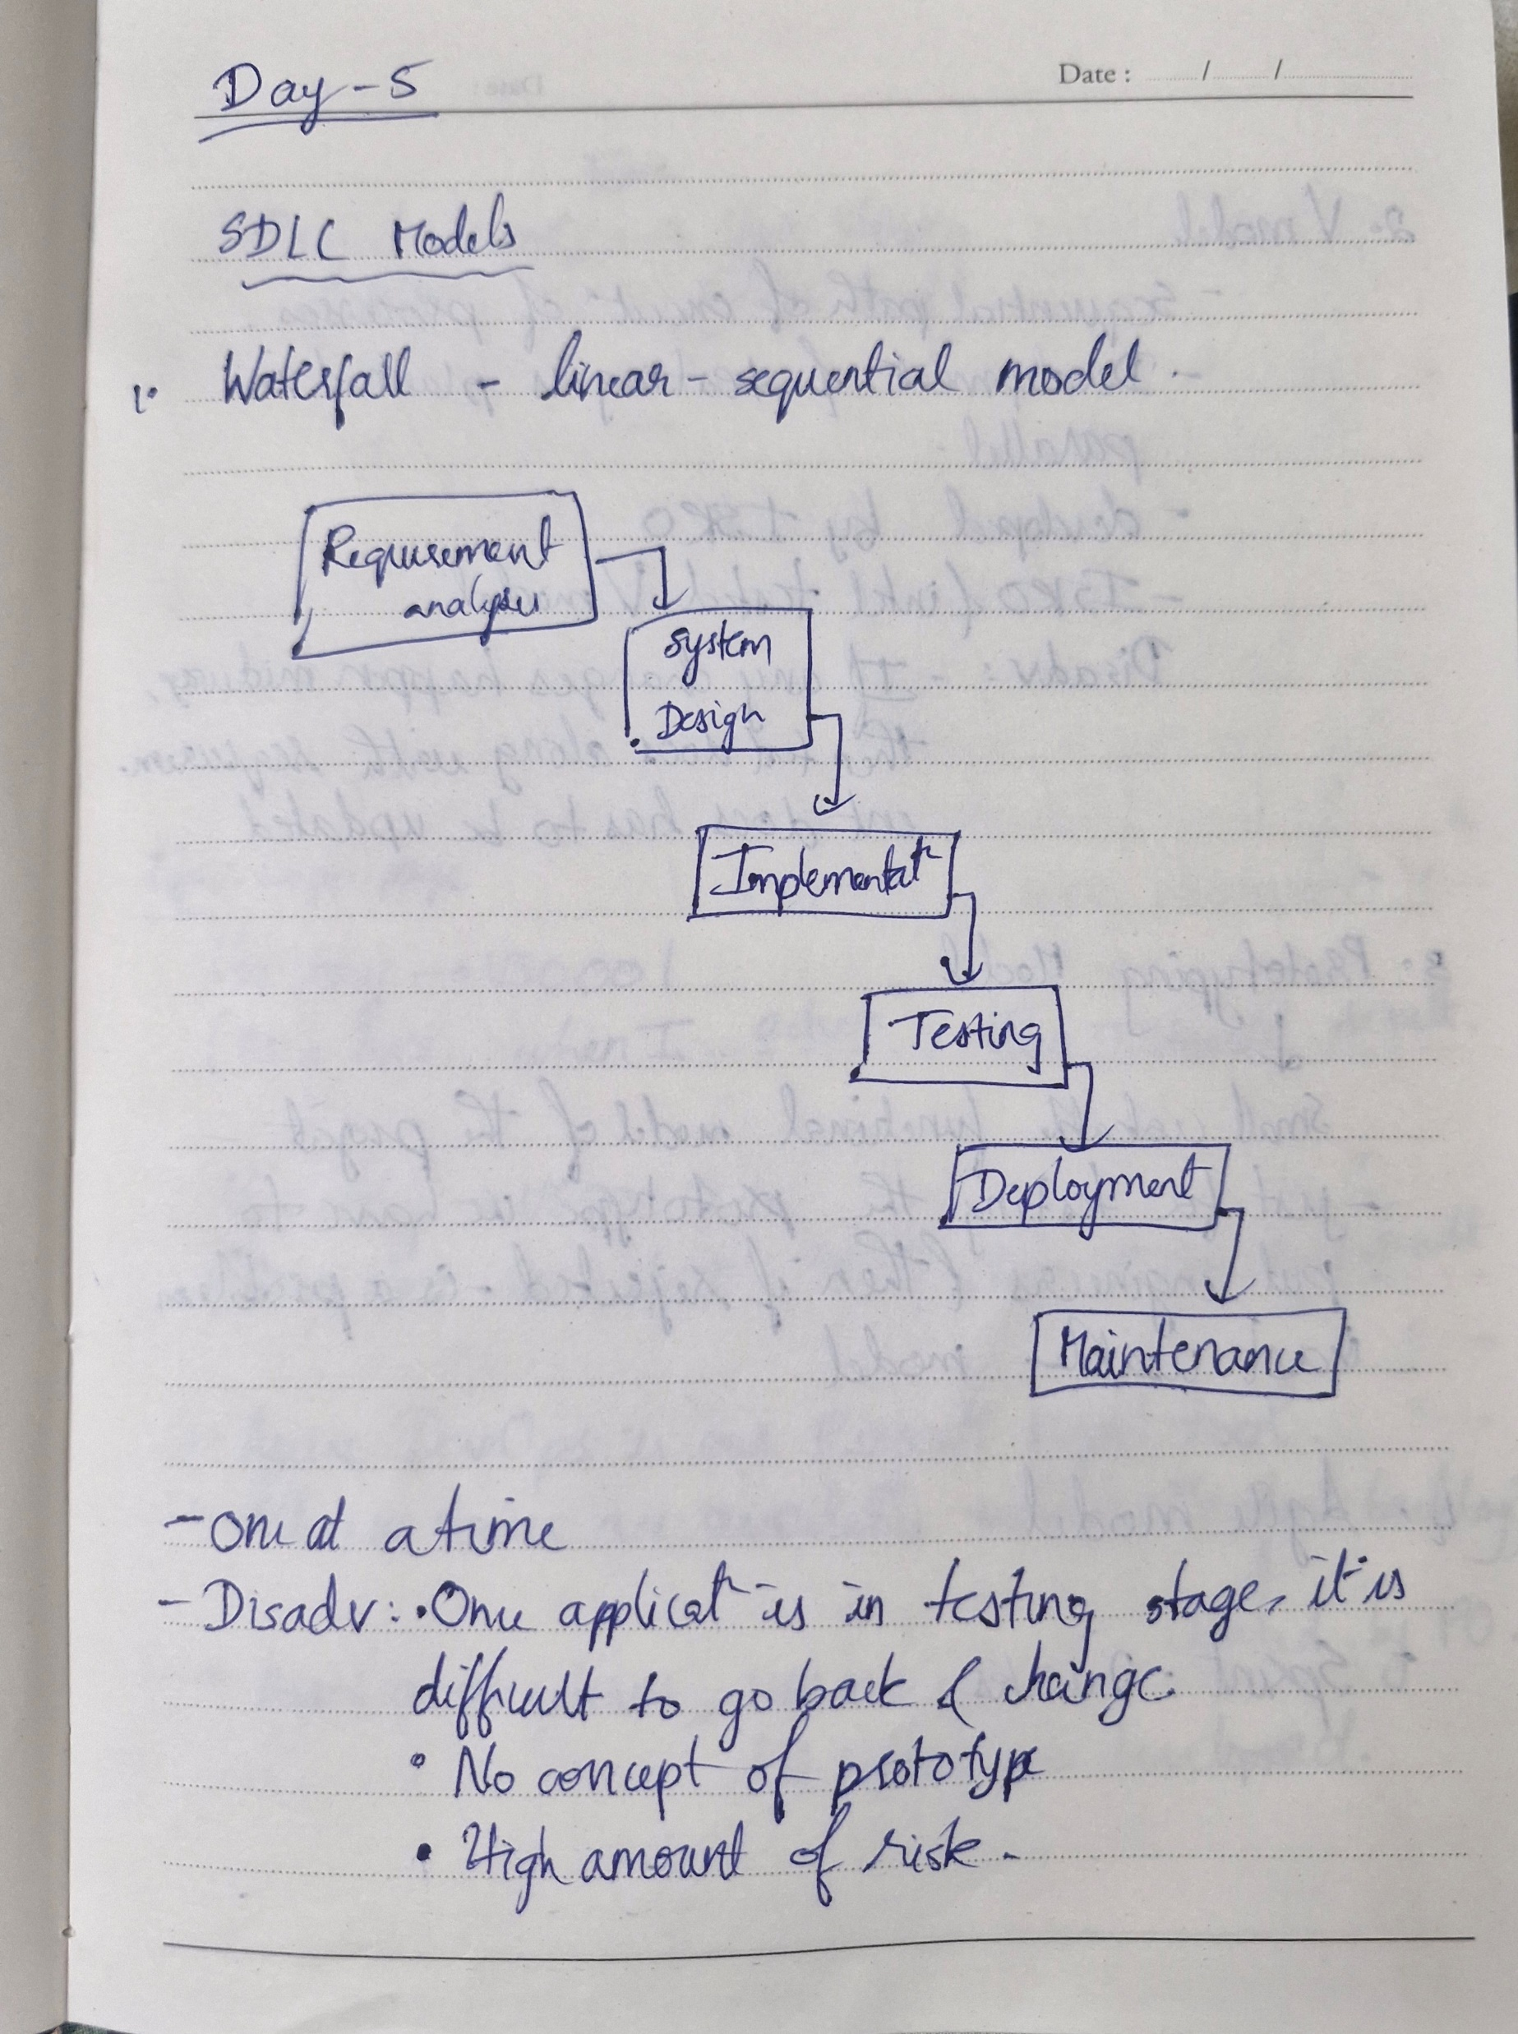
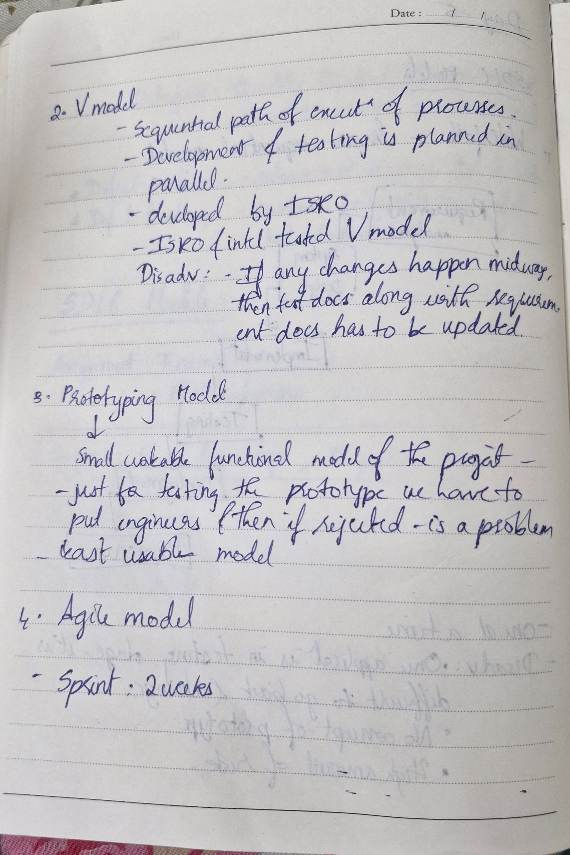
Learning 4 | SDLC models and Agile Scrum ceremonies
How I feel Shell implements this learning
Shell uses Agile model and usually a sprint of 2 weeks.
How I feel Shell benefits from this learning
Shell can keep their client informed every 2 weeks and can get appropriate feedback for the same.

Slide 13

Challenges in implementing learning

Slide 14
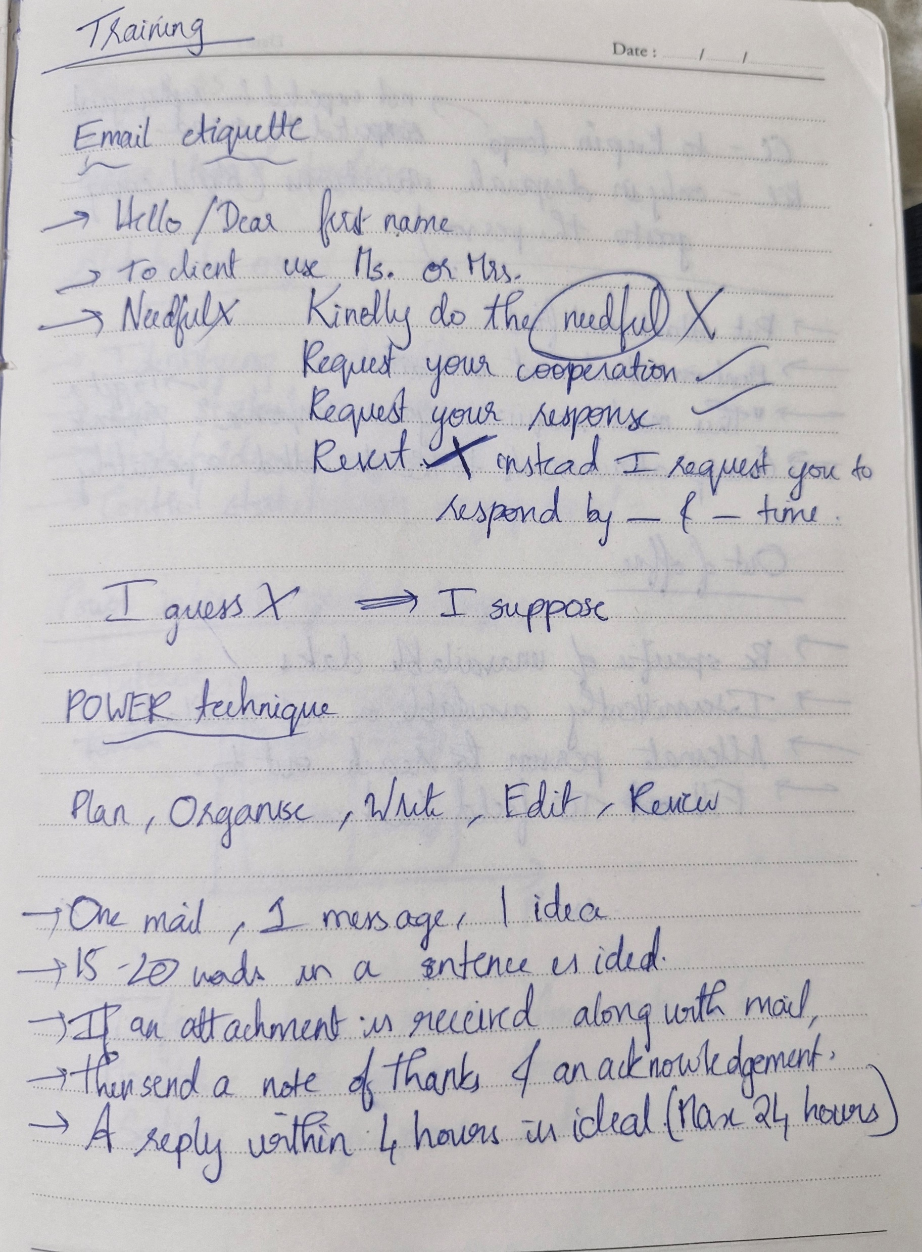
Challenge faced while implementing Learning 1
What were the challenges I faced while implementing Learning 1 and my plan to overcome them
Writing a mail in formal language.
Overcame them by practice.

Slide 15
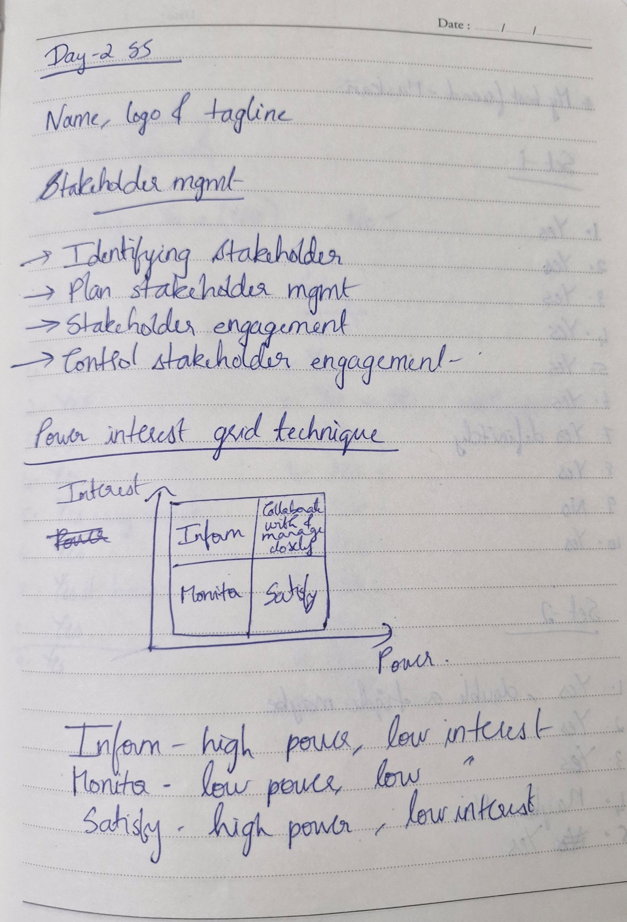
Challenge faced while implementing Learning 2
What were the challenges I faced while implementing Learning 2 and my plan to overcome them
Identifying the stakeholders and classifying them
Overcame the challenge by spending considerable amount of time in understanding the types.

Slide 16
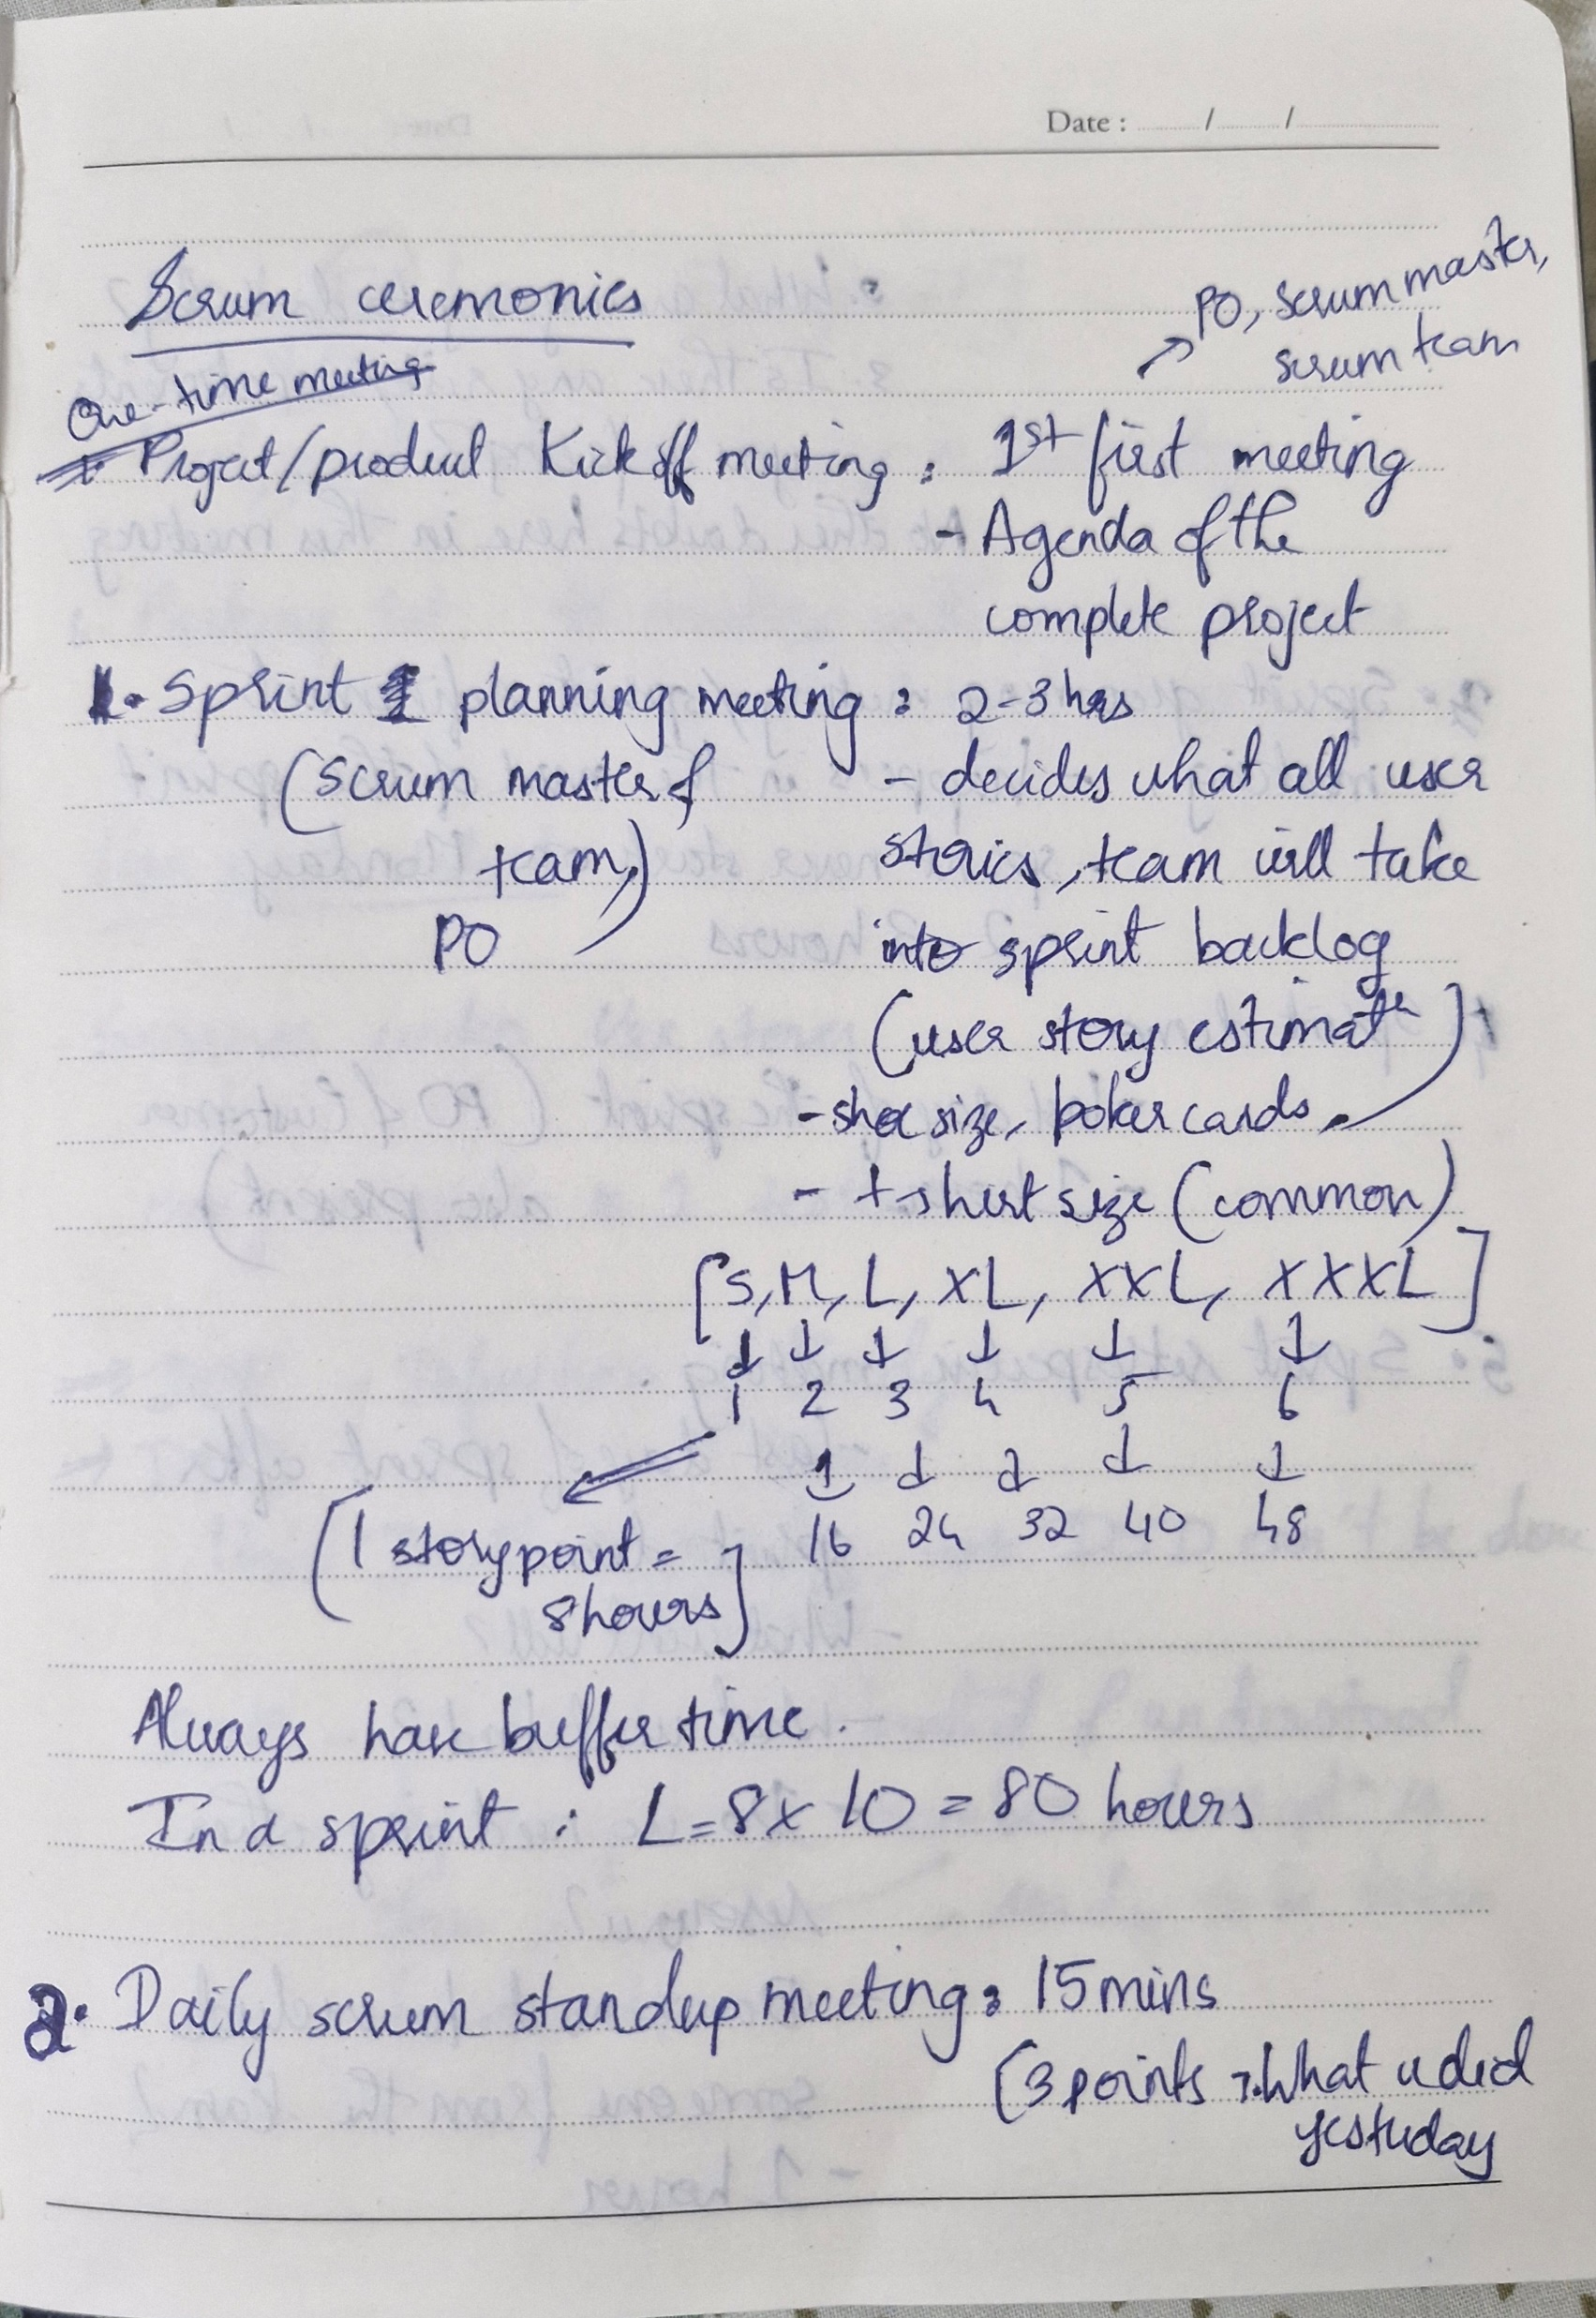
Challenge faced while implementing Learning 3
What were the challenges I faced while implementing Learning 3 and my plan to overcome them
Initially designed a BRD Document without the platforms mentioned.
Later included them and removed all software related information from BRD.

Slide 17
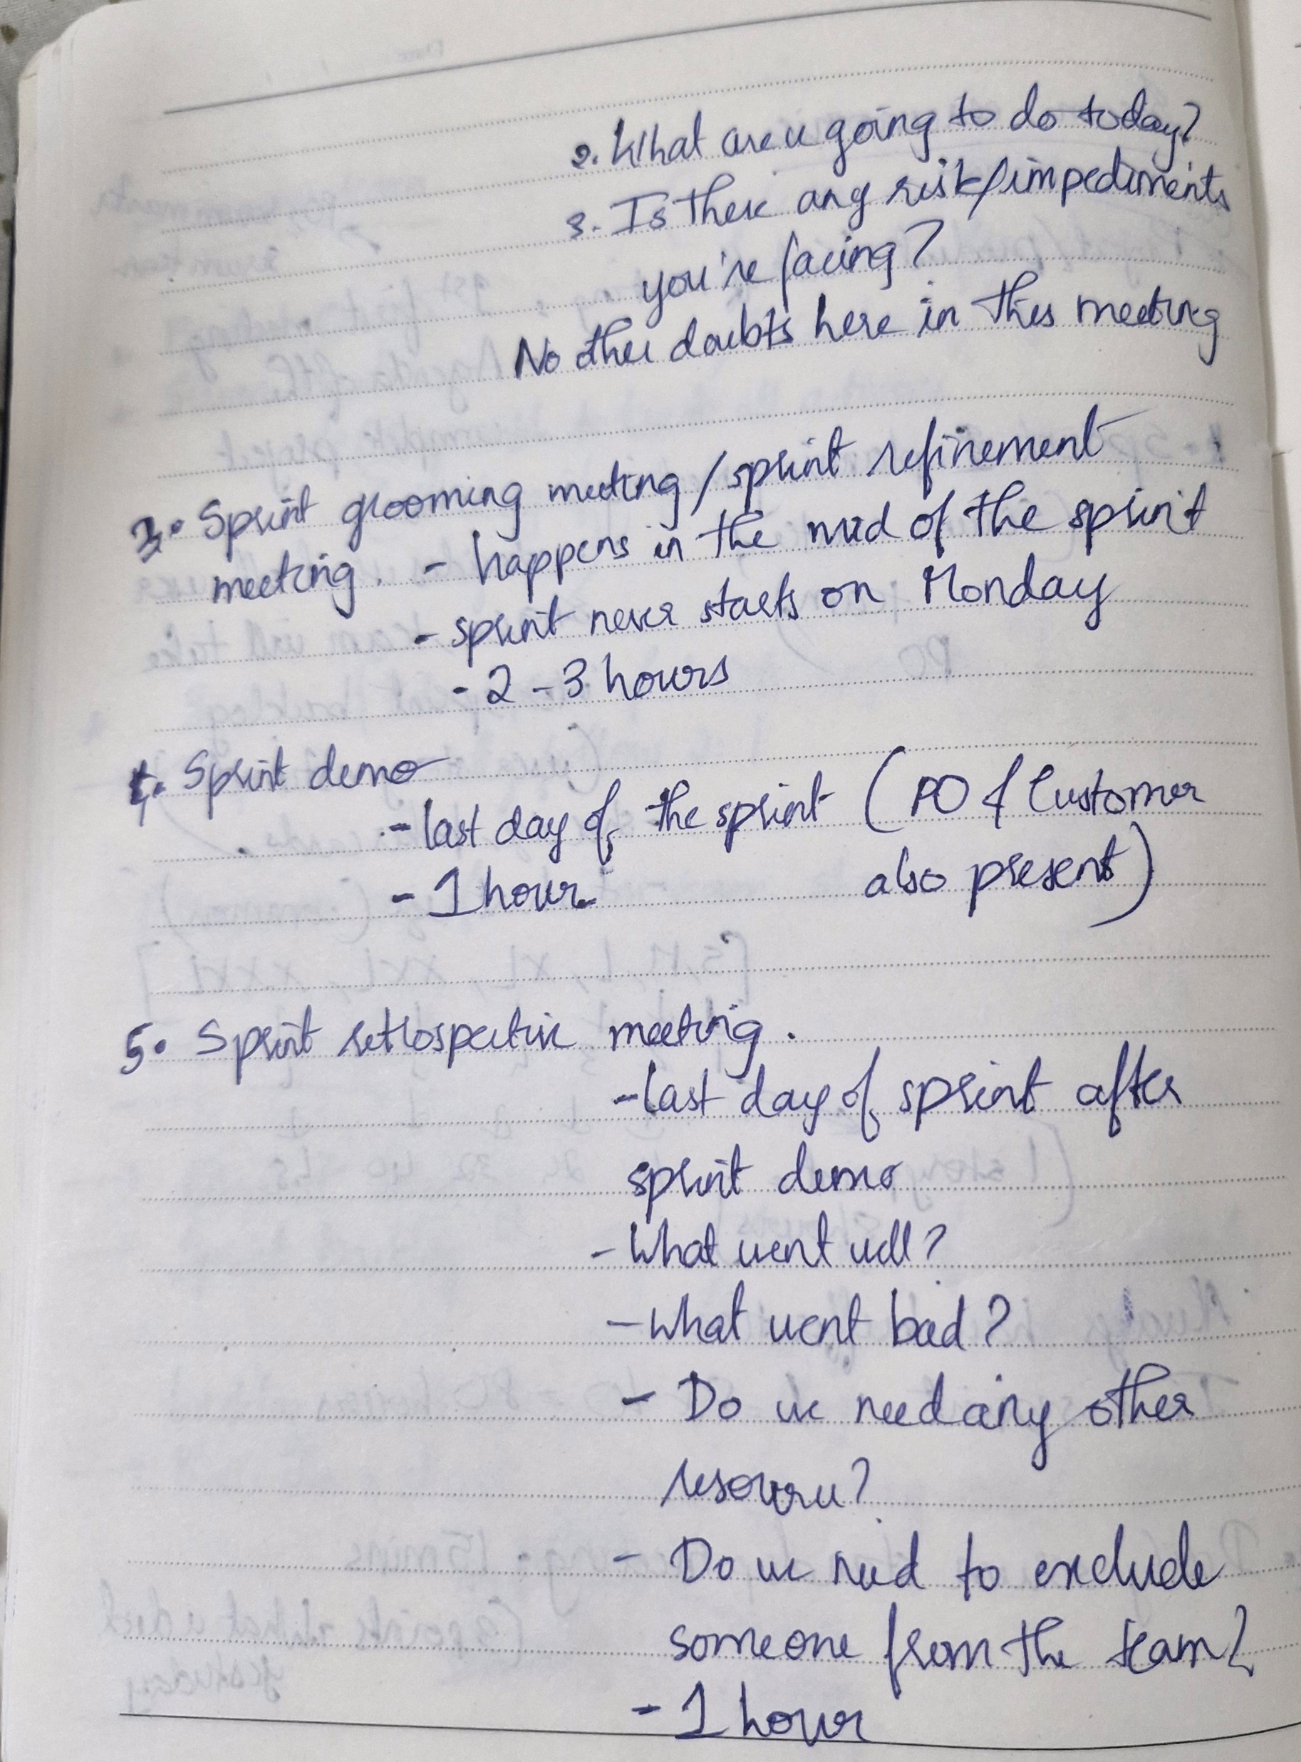
Challenge faced while implementing Learning 4
What were the challenges I faced while implementing Learning 4 and my plan to overcome them
Theoretical concepts were completed.
Yet to implement them.

Slide 18

Action Plan

Slide 19
My Action Plan for this Week
Actions
Timeline
Status
Understanding these topics:
Soft skill Training
BA
Agile
This week
Thorough understanding of these concepts and ready to implement.

Slide 20

Learning is also Fun!

Slide 21
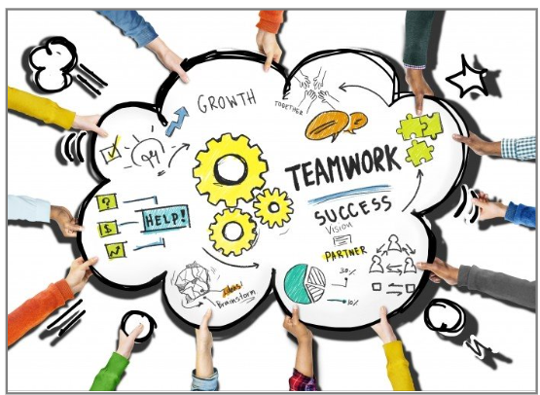
Learning is also Fun!
The learnings for this week was very fun and interactive.
Special fun activity: Team activity of writing a 6-letter word by 4 members on the team on paper.

Slide 22

Summary
Soft skill training
BA & Agile
Topics for next week: Software testing, DevOps, Cloud, DBMS, Case Work

Slide 23
Thank You

